Slide 1






Piet de Visser - PDVBV
Partitioning
Positives and Pitfalls…
Piet de Visser
Simple Oracle DBA
Favorite Quotes: “The Limitation shows the master” (Goethe), “Simplicity is not a luxury, it is a necessity. Unfortunately, “Complex’ solutions sell better. (EW Dijkstra).

Slide 2














Logo Cloud
Portbase
(dutch gov)
Shell
Philips
ING bank
Nokia
Insinger, BNP
Etihad
NHS
BT
Claritas, Nielsen
Unilever
Exxon
GE
Don’t waste time on Self-Inflation… but Hey, this was such a cool Idea (from a marketing guy)…
Logos of my major customers over time. If you want your logo here: Hire me.

Slide 3



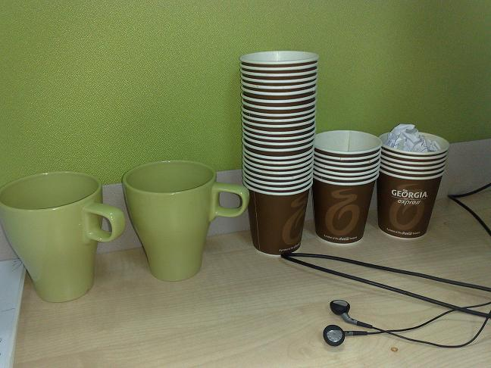
What does it look like..
Couldn’t resist… after this changing room, not allowed to take pictures anymore..
For travel pictures from Asia: later…

Slide 4
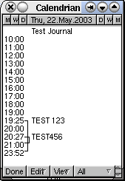
Agenda (45min +/- my “Dev” preso.. )
Partitioning…
[ Pole …or maybe an audience poll ]
Partitioning…
Summary: Keep It Simple.
10+ min Discussion (Do Challenge!)
Agenda. No longer allowed when presenting online (c.f. Connor…)
Oh, BTW: I am known for Typos.. Find a typo = get a drink..

Slide 5
Basics; Why Paritioning ?
Partitioning: Split 1 table into “Many”
Two Main Advantages:
1. Avoid Redo
2. Scan less data on Qrys.
Many more… later.
Compress partitions..
Read-only, storage tiers
Partial indexing
Ref-partitions.
Hybrid Partitioned-tbls…. WOW!
Later (next month’s ppt...)
Two main Advantages, will try to illustrate both
Piffalls later… other advantages: later. (add coffee break…)

Slide 6
Table and Index. Conventional.
1
4
2
2
3
1
4
3
Table
(Global) Index on ID
A quick illustration of table and indexes…. Data in the tabler is randomly spread out,
but the inxexes contain ordered lists and pointers to thre table-records.

Slide 7
Partitioned tables… (and local index)
Smaller pieces
“known” content
Still 1 Table.
Local index !!
1
1
2
2
3
3
4
4
A quick illustration of (range) partitions and local indexes…. Partitions are just small tables with known (ranges) of data.. Oracle “Knows” those ranges.

Slide 8
Partitioned tables; Global index; Active=‘Y’
Table still Partitioned..
GLOBAL index,
Points to all Parts
N
1. Active=Y
N
2
N
3
Y
4 Active=Y
Global Index
illustration of GLOBAL indexes… The index is now One Single object, Pointing to all partitions.
The impact of this will be noted later: on Redo and on Queries.

Slide 9

1st Advantage: Less Redo (on delete…)
Ins / Upd / Del is “Work…”
Undo + Redo…
Redo = Arch = Stndby…
Delete?
Truncate or Drop is “Faster”
You Can! - Drop Partitions!
But…
Only if your data is suitable.
Only on “delete” (or exchange partition)
Explain deleting old data with dorp-partition.
Typical use-case: ingest + remove of data with limited lifetime in the DB.. You can save half the redo..

Slide 10
Drop Partition… (Fast, no-redo)
SQL> Alter table PT drop partition PT_1 ;
1
1
2
2
3
3
4
4
Instantaeous Delete of the “range” inside a partition. Vry Little Effort.
Note: inserts and updates will still require redo… and Global indeses.. Well, just wait.

Slide 11
Partitioned tables; Global index; Active=‘Y’
N
1. Active=Y
N
2
N
3
Y
4 Active=Y
Global Index
illustration of GLOBAL indexes… Can no longer “truncate” index, index points to whole range..
On “drop-partition, will need rebuild of index…

Slide 12
Demo time..
T = Table
PT = Partitioned table
Delete from T => redo
Delete from PT => still redo..
Drop partition => Much More Efficient..
SQL > @demo_part
SQL> @demo_part_0
SQL> @demo_part_0a (with global index…)
Explain deleting old data with dorp-partition.

Slide 13
2nd Advantage: (some) Queries Go Faster…
Scan Less Data
less blocks, less IO, less Cache
Typical use-case:
Queries / Aggregates over 1 or few Partitions.
Anti-pattern:
Loop over All Partitions… (later)
Next slides: show me how..
Ideally, queries scan as little data als possible to return results .. Fast
Redue the work…

Slide 14
Aggregates, FTS over Conventional table
Data all over the Table..
Select Sum (amt)
Where [range]
Group by ..
Probably FTS
4
2
1
3
Table
Data can be all over the table..
Hence FTS or inefficient range-scan + rowid-access needed…

Slide 15
Aggregates on Partitions: less data to scan?
IF… we know where to look..
Then… FTS on…
just 1 Part. ?
Design !
Know your data.
Control your SQL
1
2
3
4
Some (most) searches / scans can be limited to just the relevant partitions..
This Will Only Work if we can eliminate sufficient partitions. (Design!!). - note : No Indexes.

Slide 16
Demo time..
T (Table)
PT (partitioned)
Select Range, SUM(amt)
From T/PT
Where range Between 10000 and 19999
Group by Range;
SQL > @demo_part
SQL> @demo_sum
This is what we will see. In demo.. -- What do we Expect ?
(don’t forget to initiate the data)

Slide 17
More Queries: Find Specific Records
Where ID = :n
Easy, use local index.
Where Active = ’Y’
Global index.. But … Redo?
Local Index.. But … How many Partitions ?
Anti-pattern:
Loop over All Partitions…
When you need “Fast” return of a small set, you need an index… Global or Local
But avoid having to loop/scan many partitions…

Slide 18
Conventional. QRY on PK.
1
4
2
ID = 2 ?
PK lookup
2
3
1
4
3
Table
(Global) Index on ID
A quick illustration of table and indexes…. Data in the tabler is randomly spread out,
but the indexes contain ordered lists and pointers to the table-records.

Slide 19
Table, index… QRY on Active=Y
N
4 (active=Y)
N
Active = y ?
Range Scan
2
N
1. (active=y)
Y
3
Table
(Global) Index on active..
Same situation, different index.
The few active=Y fields can be all over the table (and in all partitions..).

Slide 20
Partitioned table + local index on PK
1
1
2
2
Id= 1 ?
3
3
4
CBO “knows”:
Only 1 partition…
4
Searching for the PK or partition key is Easy… Visit 1 local index, and find the record.
CBO can see from the where-clause which (local) index-partition it needs…

Slide 21
Partitioned tables; Global index; Active=‘Y’
N
1. Active=Y
N
2
Active=Y
N
3
Y
4 Active=Y
Global Index
illustration of GLOBAL indexes…. And the ups and downs
Point out the need for rebuild if you drop 1 partition: 25% of pointers is gone…

Slide 22
Partitioned table, LOCAL index, no key….
1 Active=Y
N
-
N
Y
2
Active=Y
N
Y
3
N
Y
Now for 7 x 365 partitions..
4 Active=Y
Local Index
If the SQL does not gives us a clue for the Partittion,
We need to Search Through Every Local Index… (Parition-Range-All.. Looping)

Slide 23
Demo time..
PT (partitioned)
Select id, active
From PT
Where active = ‘Y’;
Compare GLOBAL and LOCAL index.
SQL > @demo_part
SQL > @demo_part_1
This is what we will see. In demo.. -- What do we Expect ?
(don’t forget to initiate the data)

Slide 24
Warning; What to Avoid…
Avoid Global Indexes
They cause Extra work on drop-partition
Avoid “Partition Range All”
Looping, multiplies the work…
Consequence:
All Qries Need “The Part-Key”
Up Front Design!
Two main Advantages, will try to illustrate both
Piffalls later… other advantages: later.

Slide 25
Bonus-Trick: Devise a PK-Key.
(not saying this is a good idea…)
No Global Indexing….
Only 1 Unique Key.
Hence UK = Partition key.
Id = YYYY DDD SSS nnnnnn
(did I say: Up Front Design?)
Two main Advantages, will try to illustrate both
Piffalls later… other advantages: later.

Slide 26


Fast - and Scaleable
Individual actions; must be efficient
C reate / Insert (1 x)
R ead / Queries (Nx, which fields, why?)
U pdate (Nx, which fields ?)
D elete (1x, bulk/del old data?)
…. Efficient ? Indexes !
Concurrent actions; must remain efficient
Limit locks (no blocking of others)
No unusable indexes (exch. Parts. !)
No hot-blocks (buffer busy waits).
Image:
Scale..
Measure individual activity (of Critical components) – can be a bit of work, but once you “get it”, its not hard)
Then think & measure your concurrency issues : does it remain efficient, doest it scale…

Slide 27
Partitioned tables… (and indexes) ….
Table: Records in random order.
PK/UK: Unique value(s).
FK: +/- good practice.
Other Indexes (e.g. status, zip…).
Index
(PK)
Index
(UK)
Index
(other)
Table
A quick illustration of indexes…. And the ups and downs
Nothing you don’t already Know.

Slide 28
When is something “efficient”
OLTP typical numbers ? (check your StatsPack)
How many LIOs (gets) per transaction ?
how many gets/execute ?
How many gets/row ?
IMHO (no golden rules): (but check v$sql …)
< 10 gets/row (B-level + table-access… <5)
< 100 gets/exe
< 1000 gets/trans
Why these numbers ? Easy to remember.
NO Rules - YMMV!
Just my opinion on what could be “efficient”. Your Milage May Vary!
And tuning by Ratios is soo 1990s… Wonder what this will be like in 10 years time…

Slide 29
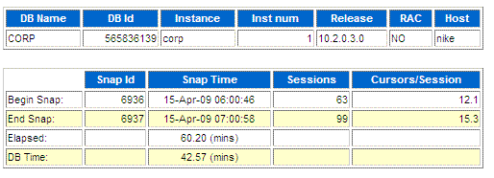
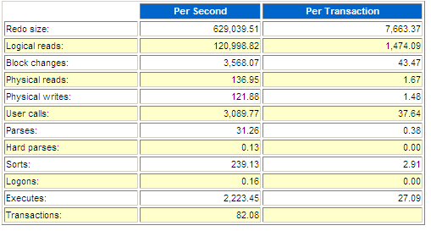
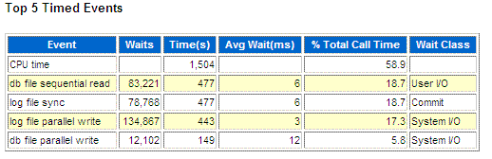
What to look for (random examples)….
And … Is your Customer Happy ?
Reading AWR is a topic in itself. The numbers are important, but the customer is more important (duh)
Serious Performance nowadays is about measuring time and resources, the top-5 AWR and the MilliSeconds….!

Slide 30

From the start ….
OLTP: Anticipate, Plan (+ Verify) Access-Paths ….
Indexes!
Clusters (indexed), Hash Clusters.
IOTs
The only way to Data... (index or…. FTS)
But anything Fast… (<100 LIOs)
Needs a good Index (or a hash).
Blog : Richard Foote.
Book : Tapio Lähdesmäki
Anything that needs ms responses on any amount of data… needs an Index.
The index is your Road to Data! Indexes Show the Way. (CBO just reads the map, or uses TomTom)

Slide 31
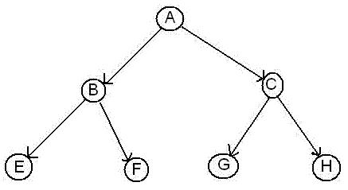
Index: good, better, Best …
Any (Btree) index is: Data + pointers, stored in Order.
Index + statement, (DBA and Dev) must work together:
Good: Leading columns in the Where-clause
Better: All where-conditions in the index (smallest slice)
Even Better: Order-by from Index, Prevent sort
Best: All data from Index, don’t visit the Table
Various books, but … Tapio Lahdenmäki !
All you need to know about “good” indexing.
Demo .. SQL > @cr_di.sql: try the 1st part demo….
Image:
Road map
Tapio : “the book” on indexes. 1, 2, 3 stars and Fat-indexes.
Demo: cr_di.sql (create demo index) – show explain, shnow nr-gets per sql.

Slide 32
Scenarios…
Table
Index
(PK)
Index
(UK)
Index
(other)
Find 1 Record on PK/UK: Precise.
Find records on Index-conditions: OK
Find records on Index + Table conditions: More Work..
Find + Sort Records: again more work…
Reason + Measure ! (SQL > @cr_di.sql, part 2)
A quick illustration of indexes…. And the ups and downs
Nothing you don’t already Know.

Slide 33

Neat trick #1 : Overloading.
Index-overloading; a known trick:
More fields in the index, Favor Index only-access.
You can also do this for Constraint-indexes!
PK, UK or FK Index _Can_ contain more data…
Useful to load a “status” or “date_effective” column
And reduces Density! (recs/blck) - Buff-busy waits on PK…
Beware of the downsides (DML + Redo) !
Demo: Owner, Table_name, num_rows, status, …
PK constraint with extra fields in Index… ( SQL > part 3 or @pk_overload_1.sql )
Image:
Loaded
Often-used “satus” fields can be added to the most-used index and save in two ways: less index-data to scan, and less table-access required. Another bonus: Denisty decreases! - google : Richard Foote!

Slide 34

More to Indexing…
Index-Reverse:
Only for Equal Predicates!
To Fix Buff-Busy-Waits or to help “RAC” (old fix)
Most Selective Columns first…?? (partly myth)
Only If you have choice…and If Relevant for Queries
Compression of indexes…Yes! (less IO, less work)
If Non-selective columns come first.
Use Analyze-validate struct: index_stats
Caveat: upserts wreck havoc…. TEST!
Wishlist: Compress Indexes per partition.
Reverse: only if you have Buff-busy-waits. Column order is a bit of a myth, not always relevant, and often not much choice. Compression: Works wonders on read-only Varchar-data, but sometimes turns against you.

Slide 35


Other Paths into data: clusters.
Clusters (indexed)
Group data with same cluster (parent-)key (=Often Good!)
Need regular, predictable data and good size-estimates.
Clusters (hash, and hash-ordered)
Potentially The Fastest Way into Data (google: Joze)
Equal-Predicate only (or use index)
Spread + Group the data, children of one Parent..
Size Estimate, requires regular and predictable data.
Anyone Using Clusters ?
(benchmarking, predictable data and predictable operations!)
Image:
cluster?
Clusters often seem promising, but the “size” estimate requires predictable data.
Willing to learn on this one! Someone do a ppt on this next Conference ? (demo_sthc.sql if time)

Slide 36

Other Paths into data: IOT 1/3
Index Organized Tables
Overloading to the extreme: all data in the PK.
Group and Order data by leading columns
Ideal for Parent-child tables: Children Forced together.
Also Good for (small) Lookup-tables (TomK, RichardF)
IOT : one less segment..:
Thumbs
UP
PK + Data
(IOT)
Index
(UK)
Index
(other)
IOTs simply don’t have “tables”, all data is in the PK.
You have one less segment, there is no more table, no more un-ordered heap of records…

Slide 37
IOTs only get Better… 2/3
Bonus-feature on IOTs: Fat Indexes
2ndary indexes are “overloaded”
contain the PK-values (as rowid) to allow Access to PK (+data)
Good for n:m relationships and join-only access
Normally, you need TBL + PK + FK
(you can “overload” to get index-only-access)
The IOT does the overloading for you…
And removes the “table” segment altogether.
n,m
n,m
m,n
Show grouping + bonus-feature. SQL > @cr_di2.sql
2ndary indexes merit a good look! Neat Trick nr #2: automatic overloading.
Deep-down-wishlist: use 2ndary indexes as overflow-segment…. Too complicated for Fast-ppt ?

Slide 38

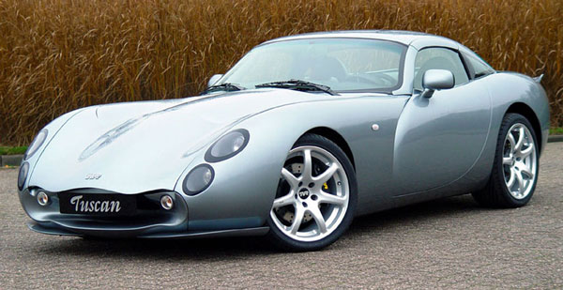
IOTs – downsides 3/3
Slow DML (ins/upd)
Especially Bulk & Batches, no “direct” insert
(people are used to bulk-loading without any indexes…)
Overflow Segment with extra columns.
Plan it – don’t get taken by surprise.
2ndary indexes are bigger
“Table” access is slower, Row-Guess(?), more “hops”
Statistics take forever (older versions?).
Bugs… (ML 471479.1 + more)
Image:
TVR
Downsides are non-negigable, as one customer noted… (ML: ) Suspect extra redo, need to test.
Wishlist: Prevent Overflow segments, or control overflow to go into 2ndary Index (e.g. avoid any heap-segment)

Slide 39
Recap 1/2
Any (Btree) index is: Data + pointers, stored in order
Index + statement, (DBA and Dev) must work together:
Good: Leading columns in the Where-clause
Better: All where-conditions in the index (smallest slice)
Even Better: Order-by from Index, Prevent sort
Best: All data from Index, don’t visit the Table
Various books, but … Tapio Lahdenmäki !
All you need to know about “good” indexing.
Demos: index, overloading, IOT.
Image:
Road map
Tapio : “the book” on indexes. 1, 2, 3 stars and Fat-indexes.
Demo: cr_di.sql (create demo index) – show explain, shnow nr-gets per sql.

Slide 40

Recap 2/2 : INDEXING
Verify Access Paths (especially on OLTP):
Explain, (auto)trace and check v$sql and v$sql_plan
Good Indexing: good, better, best…
will help you more then anything
Overloading is useful
Index-Compression is useful (but test)
Clusters and IOTs … If applicable (but test)
Now for the C-B-O… (paracetamol…)
Just to stress – and this is striclty my own humble opinion, but I will shout it aloud!
Do you notice we havnt lost any time / sleep over CBO yet ?

Slide 41


Optional Intermezzo: Poll for audience
Thank You !
Stay Tuned
(not done yet…)
Who has/knows/uses:
Log-file-sync waits (how many TPS?)
Buff-busy waits (what segments?)
Gets/exe of critical queries ?
Fat or Overloaded Indexes ?
Clusters ? IOTs ?
Outlines, SQLPlans,
Hints
Early morning cursor-shooting
Lock or Restore Stats ?
Find out from the audience.
Bonus question: who prefers init-files ?

Slide 42
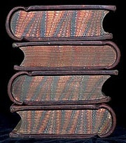
Eh, just to remind you … Simplicity
Leonardo da Vinci:
Simplicity is the ultimate sophistication.
Goethe:
In der Beschränkung zeigt sich der Meister".
EW Dijkstra:
Simplicity is a pre-requisite for reliability.
The sore truth is that Complexity sells better
www.brainyquote.com,
Quotes from Leonardo da Vinci, Albert Einstein, and Edsgar W Dijkstra.

Slide 43
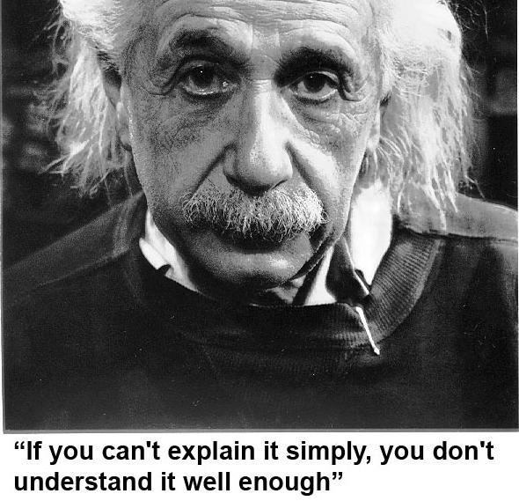
He got it …
As Simple as Possible, but not too simple
Simplicity is a Requirement - but Comlexity just sells better (EWD).

Slide 44

Take-aways for “Architects” + DBAs
Define Efficiency:
Get a feeling for your system – Statspack, AWR, v$sql
INDEXING : all Access should be “efficient” – check!
CBO: be lazy, dont tweak (not too much).
Stats: Auto-gather, and use a window
Trust but Verify : save SPM plans for a rainy day
Inspect your stats on problem-qries/tables.
Tweaks (set-stats, use SPM)
Sometimes you have to…
Minimize and simplify
Oh, and “Oracle is Great, and Larry is its CTO” … (I have to say this now that I got “ace”)

Slide 45

Advice.. (the hardest slides…)
Simplicity
In case of doubt: Simplify!
Less Tweaks, Less work,
less procedures, less scripts…
Can you explain it ? To me ?
Can I take your system without paper documentation
In case there is time: SIMPLICITY!
If me, or someone like me can take over your job… (so you can do more interesting things)

Slide 46

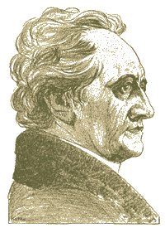
Don’t Take my word for it…
Tahiti: start with concept-guides
Technet (but be critical)
Oracle-L : real world stuff
SimpleOracleDba . Blogspot . com (Oracle ramblings)
Pdvfirstblog . Blogspot . com (more ramblings)
Pdvsecond . Blogspot . com (private ramblings)
Firefox
literature
Goethe (simplicity…)
Majority of times, I have been WRONG.
So go see for yourself - but don’t complicate life.

Slide 47


Quick Q & A (3 min ;-) 3 .. 2 .. 1 .. Zero
Questions ?
Reactions ?
Experiences from the audience ?
Question and Answer time. Discussion welcome (what about that Razor?)
Teach me something: Tell me where you do NOT AGREE.

Slide 48

Notes
Road + map are good metophores.
Occams Razor
Least possible ASSumptions
Simplest Solution.
LoE: Layer of Expertise ( © to Moans for this abbrev.?)
Simplicity at each Layer of Expertise is essential for a robust system.

Slide 49

CBO basics
CBO is like TomTom (= Garmin); Very Clever, but…
Do you ever mess with your Tomtom ?
You need good Roads - hence my rant on Indexes.
TomTom needs “the map”
TomTom needs good “settings”
Sometimes it needs common sense
Hints, sqlplans, SPM.
And Somtimes it needs a Spanking.
CBO… sooo much to it! I can only begin to scratch the surface…
When TomTom goes bananas, you don’t 10053 on it, nor change the settings: you use a map + brains…

Slide 50


What do these have in common…
SQL > COMMENT on table emp is ‘you are it’;
SQL > GRANT select on emp to perfstat;
SQL > ANALYZE table emp estimate statistics ;
SQL > alter system flush shared_pool;
SQL > .. You may have more of these …
Pre-11 shooting of a cursor!
Never quite “precise”, but they generally work.
New: dbms_shared_pool.purge( cursor ) (c/o “Prutser”)
Images:
Grenade
Scalpel
Early morning shooting… In ora 11, there is a method.. Check Harald v Brederode.
“Precise, targeted Fixes” are always better the “generic” settings.

Slide 51

CBO runs on Information 1/3
Spfile-parameters
System stats
Object Stats
Session-parameters
Outlines or SQLPlans
Hints (if you really have to…)
(and … sometimes it “needs to get lucky” – c/o JL)
Realize the hierarchy: Order
Troubleshoot from bottom to top!
There is a hierarchy in the information used by CBO. Troubleshooting should take this into account.
Start with changes that are “precise”, aimed at your problem-only, prevent wider impact of “tweaks”

Slide 52
Impact on the CBO … 2/3
Spfile: Simplify; get rid of ALL init.ora “history”.
Any change = system wide (Don’t Mess here!)
Optimizer_mode… (dflt Choose is fine)
Hash-/Sort-area-size (Session level, if at all)
System Statistics (often overlooked):
Gather on your hardware (CPUs, disk-behaviour)
Tip: Collect + Plot over time, get a feel for your system.
Set system-stats manual ?…
(See book by Christian Antognini, but Need more Info)
System stats tend to vary, notably if hardware changes (vmware, dynamic hardware provisioning) and SAN behaviour over the day – re-check the book and the docu! Funny: ML 368252.1 (for EBS users)

Slide 53
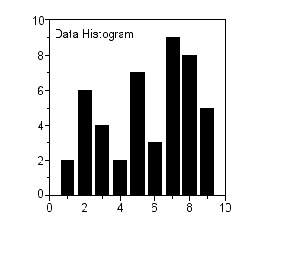
CBO needs More Information 3/3
Session-parameters
Override Spfile-parameters – for duration of session.
(I don’t mess with these, but you can…, optimizer_mode)
Object Statistics
DBMS_STATS (But I “analyze” when in a hurry)
Can be “Set”, copied, tweaked.
In doubt: use worst-case stats and LOCK.
if it works on 60M, it works on 120 records too.
New Month, New Partitions: Stale.
Session settings will (only) last for the session. Beware how long your session lasts.
Table/index_stats will auto-gather… do you want that ? What about new, “empty” objects ?

Slide 54

Gathering Stats.. (old disucssion) 1/2
Simplify ( be Lazy): Use default gather_stats_job
Gather_database_stats_job ( internal use only … ?)
DBMS_STATS = Heavy (and unpredictable)
Check the Maintenance Window
(and learn to use the scheduler )
Save Stats you trust – for re-import (=effort?)
10g: Restore-stats: Safety-net.
Retention of 31 days…
Image
Lazy
Long and hard discussions on “when + how to analyze” Just do auto-gather + stale… but…
Beware of the Job, control the window. Nb: Restore is different from exp/imp stats !

Slide 55

Gathering Stats.. 2/2
Stale, 10%... : Lock stats you trust! (but how long…?)
Check for stale anyway (=work…).
Locking of stats: for any use of the segment
Locking of SQL (hint, outline, sqlplan) : per stmnt…)
By Exception only: set or tweak stats.
Volatile tables, GTTs … maybe… (I hestiate, ... more work…)
“Upgrade took two weeks to stabilize…” (Thx!)
You need an upgrade-strategy,
Whitepaper + outlines/SQLplans!
Complications around gathering stats… sigh… the “automation” is good, but beware of unpredictable changes.
10%-stale is a bit low. Lock the ones you trust. Upgrade was my intro into “outlines”

Slide 56

Outlines: an “Emergency” strategy
I never liked outlines: too much hassle, but..
I Discovered their use on upgrades from 9 to 10.
IF you can afford to do this (1 hr work):
Get outlines of all major queries when “Good”
Then either lock m in place.
Or keep m for use and reference when needed.
This is SQL-Plan management by another name..
But I’m not on 11g yet…
Image
Lock
Collect Outlines when the system is running “as intended” and keep those just-in-case.
You can then activate one or more outlines when queries go out of control (non-intrusive!)

Slide 57
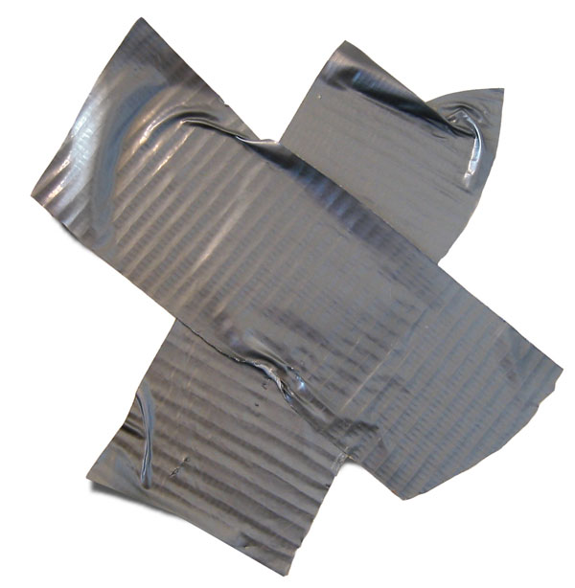

Hints… Necessary Evil
Hints are EVIL
Gremlins, time-bombs (job security?)
Maybe: on GTTs
Dynamic sampling (tt, 1) (c/o JLewis)
Possibly on “The-Cast-table” in PL/SQL
Tell CBO what is in your array
You can “catch” a hint from dbms_xplan…
(demo_outline_hint.sql – how to get in trouble…)
Hints… ongoing work… on GTT: dynamic-smple, or cardinality or ordered…
Hint (outlines) can be “gotten” form dbms_Xplan now! (11gr2: IGNORE_ROW_ON_DUPKEY_INDEX .. ? Later!)

Slide 58
Outlines (and plans)
There is a lot to outlines and “plan management”
It it becomes (complicated) tweaking….
It is probably too … complicated.
Think of an easier way !
Good indexing – good INDEXING…
Shoot qrys (but cant do that forever)
Try New, better stats
Outlines – just in case
Image ?
Time.. You cant tweak CBO forever, no matter how much Oracle wants you to…
Did I mention “good Indexing” ?

Slide 59


Keep the clipart
Frozen Plans.
More..

Slide 60


Keep the clipart
Thu, 18Feb, 11:15 (one one one five...)
Hall …,
the SIMPLE approach to Indexing and CBO
Same time: many real celebrities presenting
User Managed: Flexible, but “You run it” Dataguard: covers almost any-outage, user-errors, machine-failure, site-disasters, and great for “other usages”

